Slide 1


Enhancing Healthcare Efficiency: A Predictive Model for Medical Cost and Personal Expense Forecasting

Slide 2

Introduction to Healthcare Efficiency
In the current healthcare environment, improving eﬃciency is essential. This presentation introduces a predictive model aimed at forecasting medical costs and personal expenses. Leveraging advanced analytics enhances decision-making and optimizes resource allocation within healthcare systems, ultimately leading to better patient outcomes and ﬁnancial management.

Slide 3

Current Challenges in Healthcare
Healthcare systems face numerous challenges, including rising costs, ineﬃcient resource allocation, and unpredictable patient expenses.
Understanding these challenges is essential for developing eﬀective solutions that enhance eﬃciency and improve patient outcomes.

Slide 4

Importance of Predictive Modeling
Predictive modeling plays a pivotal role in healthcare by analyzing historical data to forecast future trends. This approach enables healthcare providers to anticipate costs, manage resources better, and ultimately enhance patient care through informed decision-making.

Slide 5
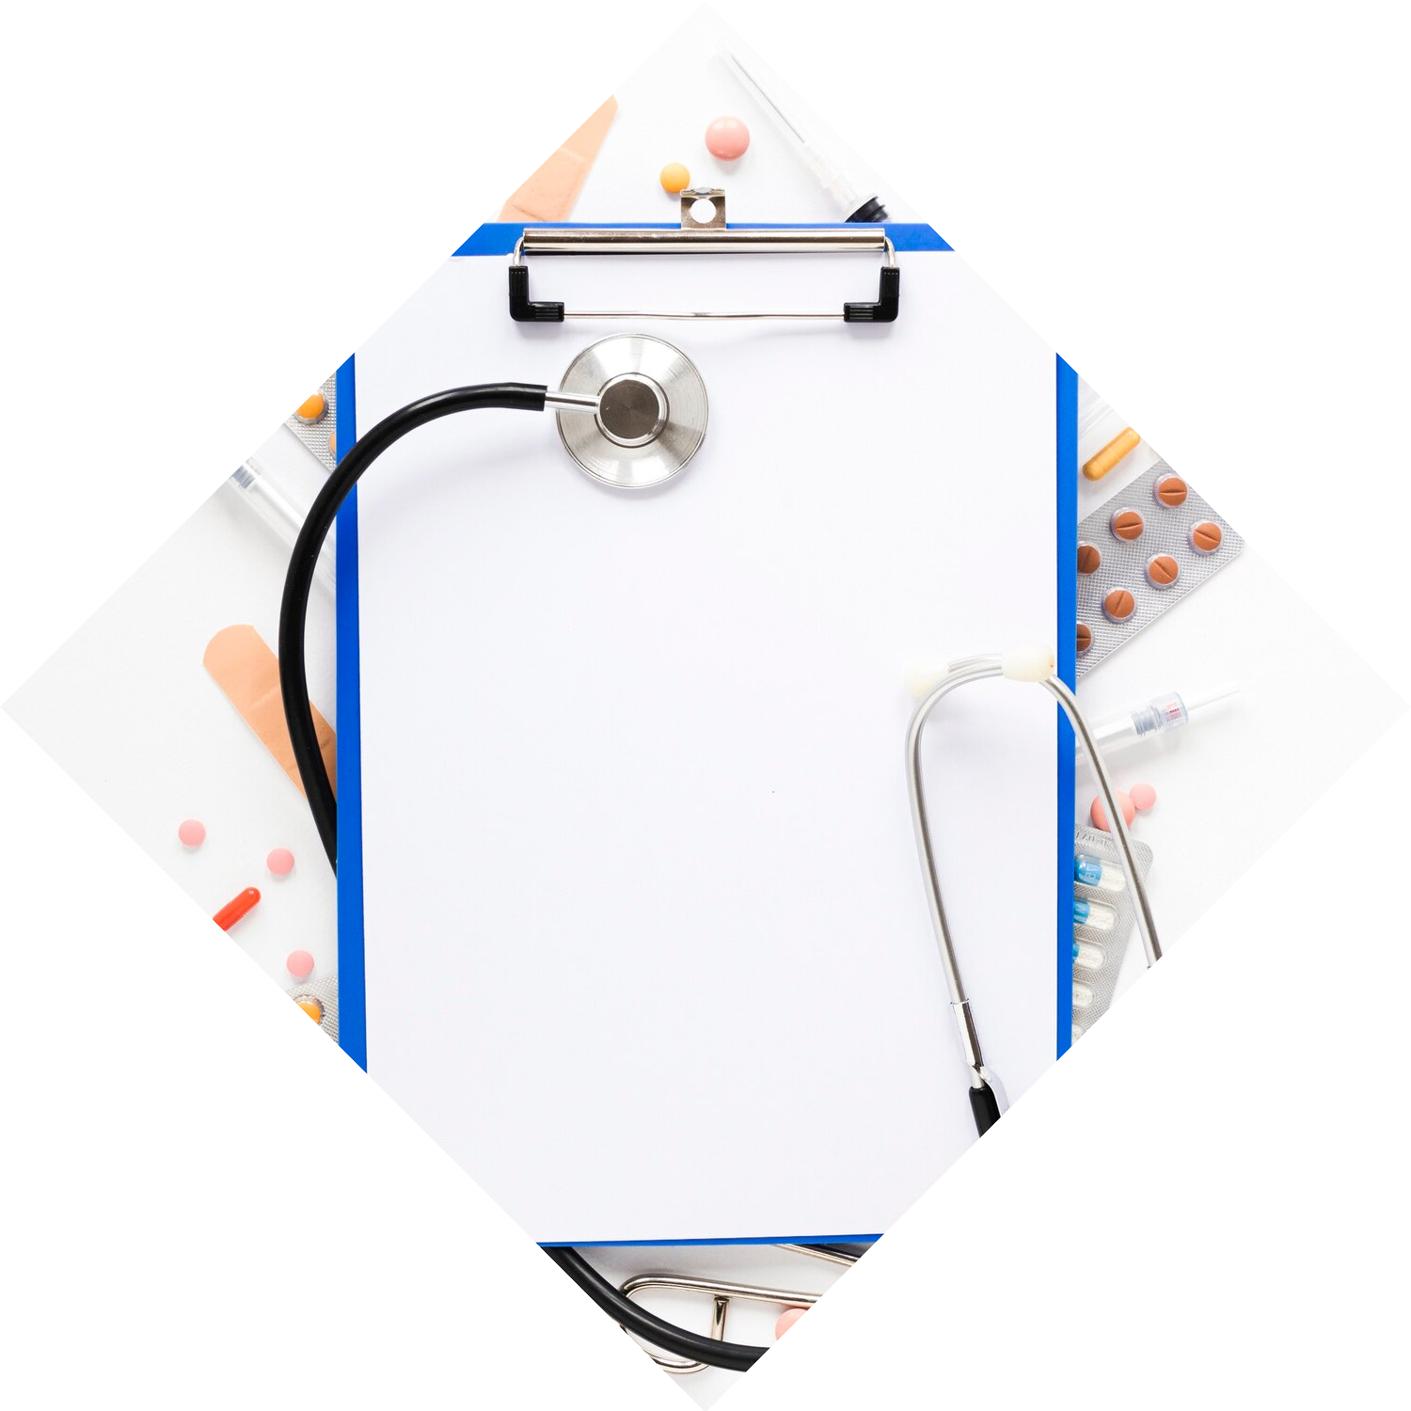
Data Sources for
Forecasting
To create an eﬀective predictive model, it is vital to gather data from various sources. This includes patient records, billing information, and demographic data. Integrating these datasets allows for a more comprehensive analysis and accurate forecasting.

Slide 6


Model Development Process
The development of a predictive model involves several key steps: data collection, data cleaning, model selection, and validation. Each step is crucial to ensure the model's accuracy and reliability in forecasting medical costs and personal expenses.

Slide 7

Benefits of the Predictive
Model
Implementing this predictive model oﬀers numerous beneﬁts, including reduced costs, improved ﬁnancial planning for patients, and enhanced operational eﬃciency. By anticipating future expenses, healthcare providers can allocate resources more eﬀectively and improve patient
satisfaction.

Slide 8
Case Studies and Applications
Several healthcare organizations have successfully implemented predictive models to enhance eﬃciency. These case studies highlight real-world applications, showcasing how forecasting can lead to better ﬁnancial outcomes and improved patient care.

Slide 9
Conclusion and Future Directions
In conclusion, enhancing healthcare eﬃciency through predictive modeling is a promising approach. Future advancements in technology and data analytics will further reﬁne these models, leading to improved healthcare outcomes and cost management for patients.

Slide 10
Thanks! Amisha Sukla
suklaamisha@email.com

